Slide 1









Assessing stability of dietary habits over time:
An Italian network of studies mimicking the general population
Sara Peri
Alessandra Valentina Espejo Rivas
Alessandro Cantoni

Slide 2

Research question
Retrieve Dietary Patterns
Changes/Stability
Are dietary patterns as derived within our Italian network of case-control studies stable?
Are there elements that have remained constant or changed over time?
A Priori Approach
Mediterranean Index
A Posteriori Approach
Principal Component Analysis
Factor Analysis

Slide 3





DATASET
7,448 observations
502 variables
First record: 01/02/1991
Last record: 01/03/2008

Slide 4

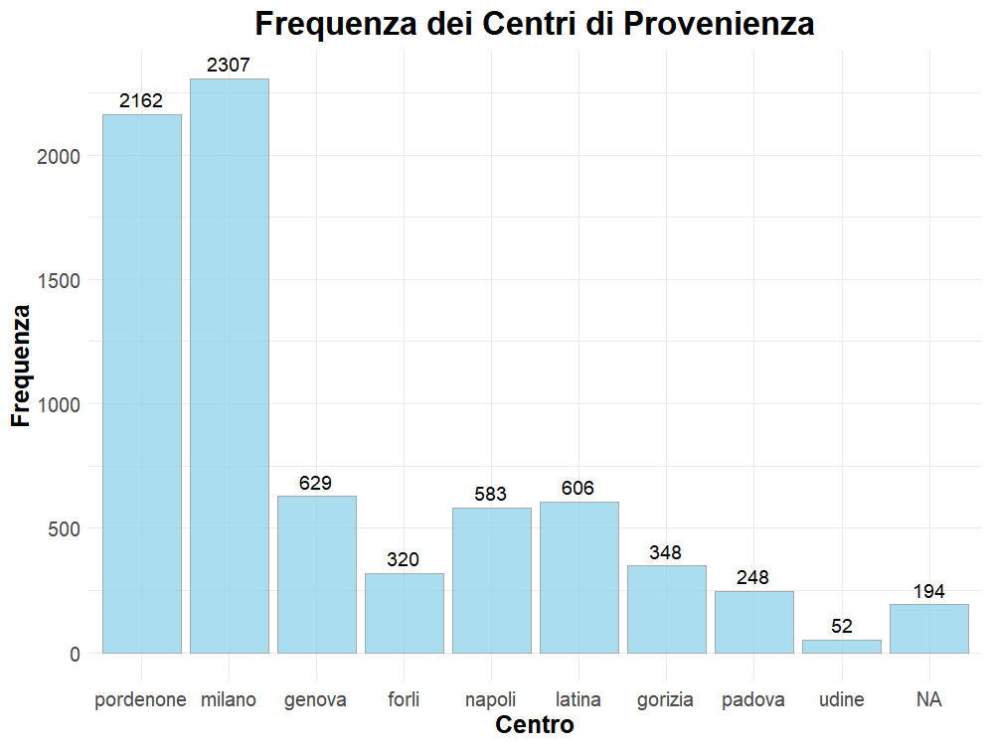
Dataset - Analysis Center
A very large number of observations were taken from centers in Milan and Pordenone, which together account for approximately 60% of the entire dataset.

Slide 5
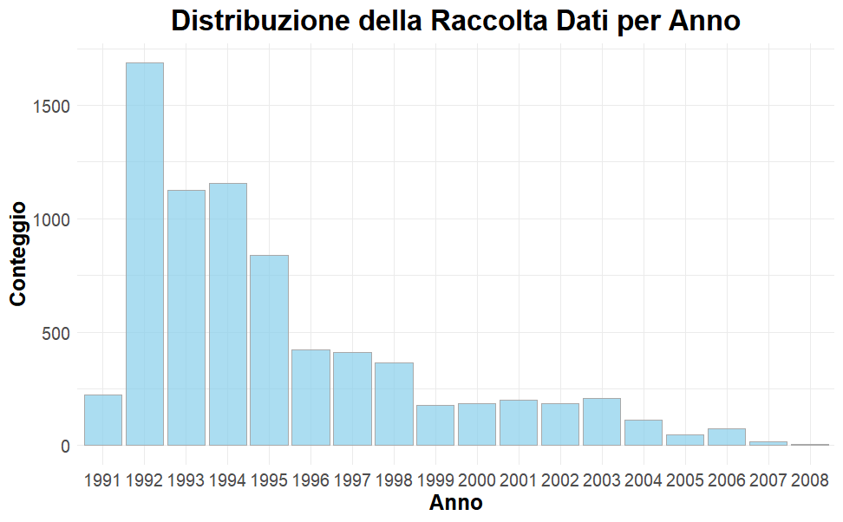
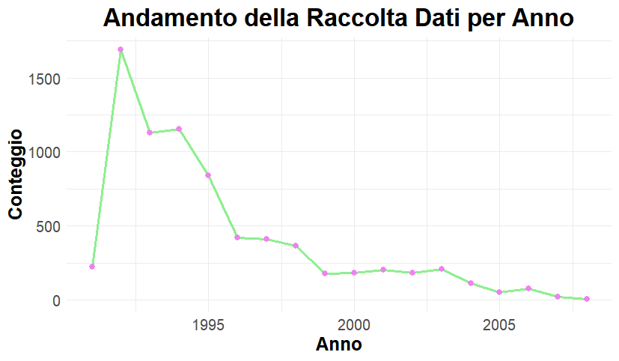
Dataset - Years Distribution
We can note that the majority of data was collected in the early years and then steadily decreased.

Slide 6
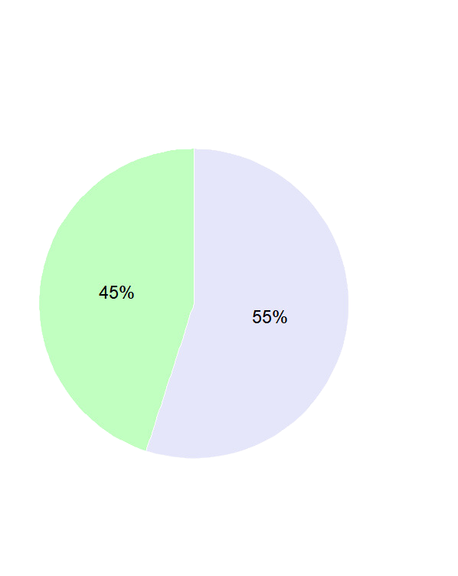

Dataset - Sex Distribution
The dataset is fairly evenly divided by gender, with a 55-45 percentage in favor of women.

Slide 7
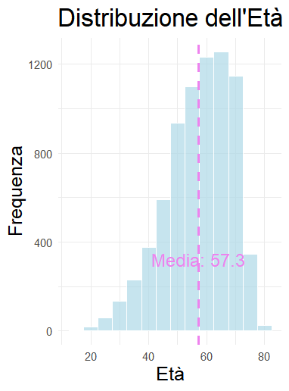
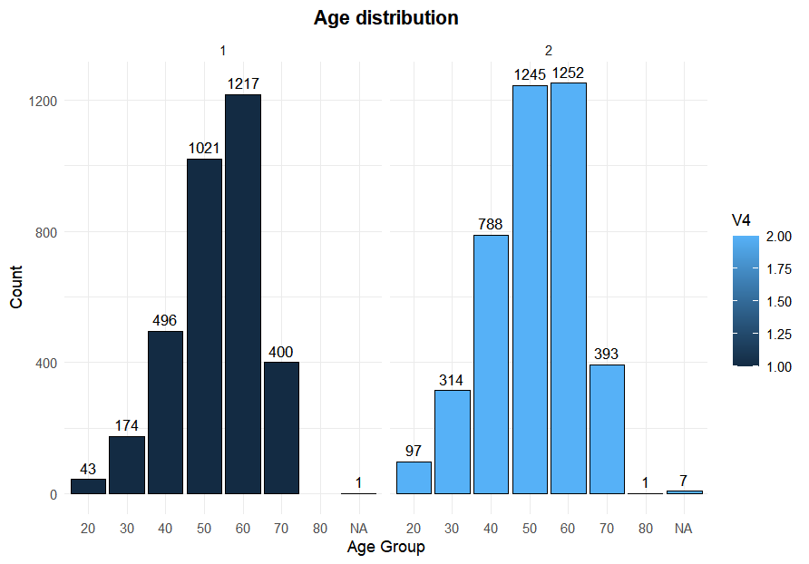
Dataset - Age Distribution
Age analysis shows a normal but very steep distribution, with the central age groups being the most represented. Dividing it by gender, the result is similar.
Male
Female

Slide 8





Mediterranean Diet
The Mediterranean Diet, rooted in the traditional eating habits of Mediterranean countries such as Greece and Italy, gained scientific recognition in the mid-20th century. The diet was extensively studied by Ancel Keys and later by Antonia Trichopoulou, whose scoring system evaluates adherence based on the consumption of key food groups and their health impacts.

Slide 9
Mediterranean Diet
Health Benefits:
Linked to reduced risk of heart disease, stroke, type 2 diabetes, and certain cancers.
Promotes longevity and healthy aging.
Supports weight management and overall well-being.
Key Features:
High consumption of fruits, vegetables, legumes, nuts, and whole grains.
Olive oil as the primary source of fat.
Moderate intake of fish and poultry.
Low consumption of red meat and dairy products.
Regular, but moderate, consumption of wine, particularly red wine.
Core Principles:
Plant-Based Foods: Emphasizes the consumption of plant-based foods like fruits, vegetables, whole grains, and legumes.
Healthy Fats: Encourages the use of olive oil and discourages saturated and trans fats.
Lean Proteins: Favors fish and poultry over red meat.
Moderation: Includes moderate consumption of dairy and alcohol (primarily wine).

Slide 10
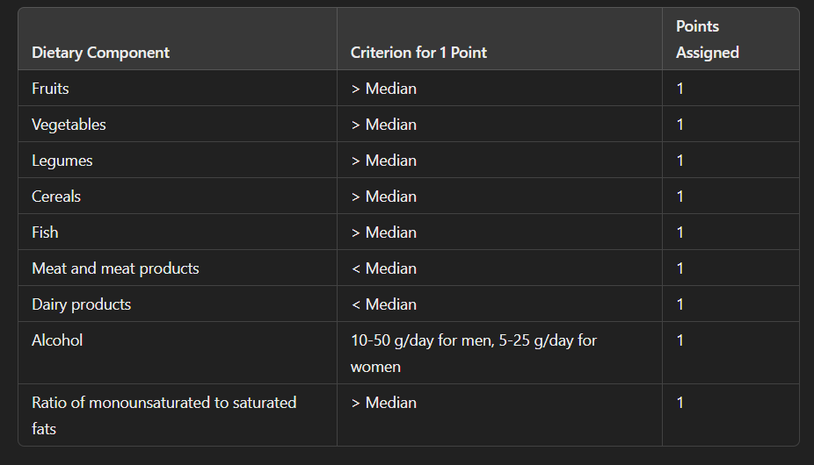
Mediterranean Index

Slide 11
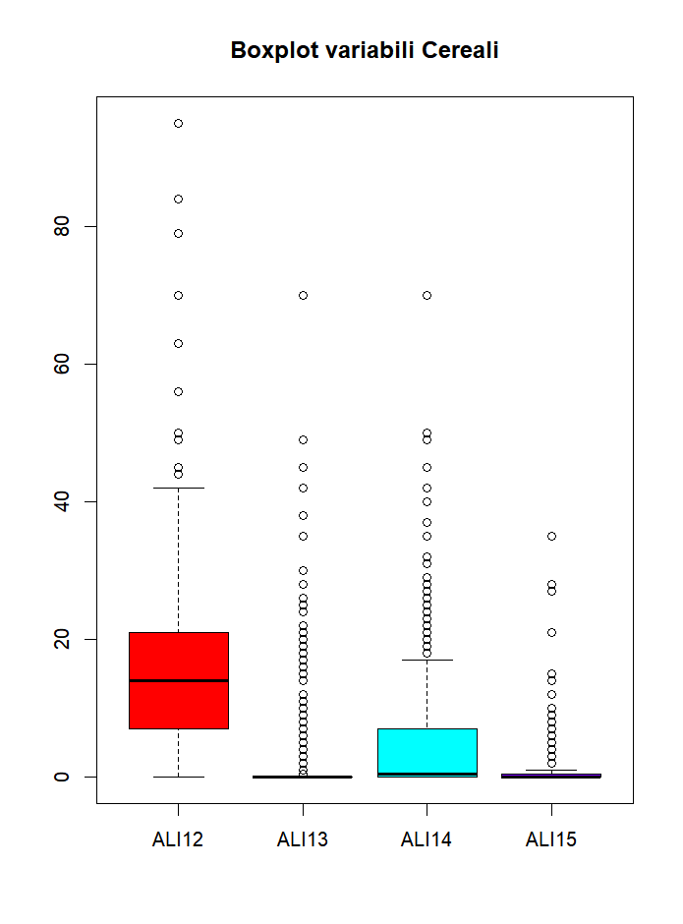

Data Retrival
For the first seven indicators, we aggregated all the values present in the database for each of them. We cleaned them of any outliers and inconsistent values (98 and 99), then multiplied them by the portions when present, finally summed them up and obtained the median.

Slide 12
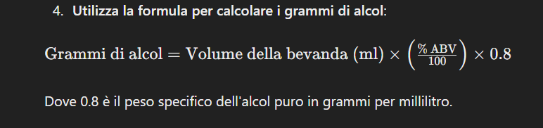
Data Retrival
For alcohol, we used the formula above that includes the alcohol content, the quantity of the beverage, and the specific weight of alcohol, in order to obtain the value in grams for each individual.
The last indicator, on the other hand, is the only case where we used pure nutrients as data to better isolate saturated and monounsaturated fats, instead of food or drinks.

Slide 13
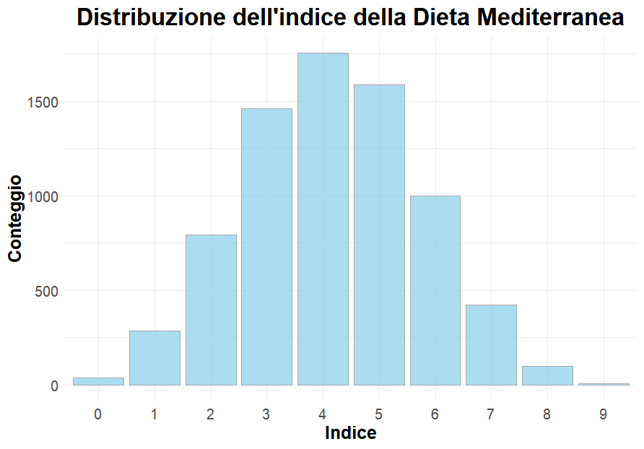
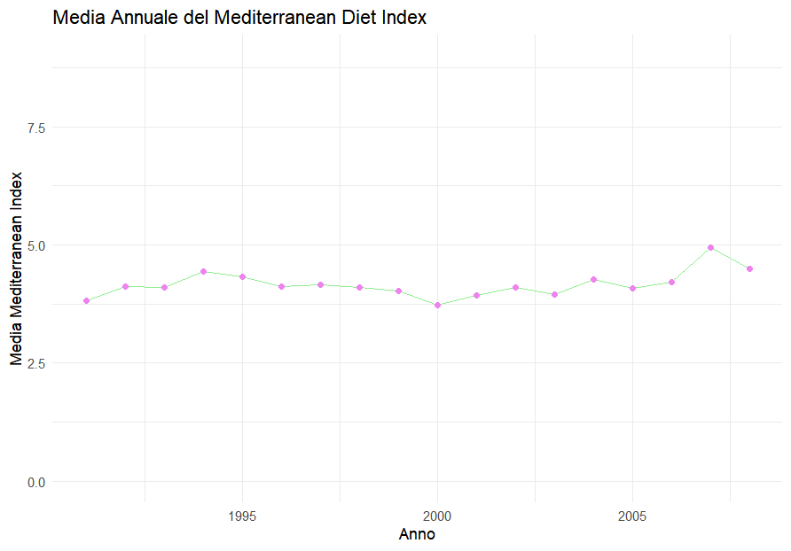

Results
These graphs show how adherence to the Mediterranean diet follows a normal distribution, centered around average scores (with values of 4 and 5 being the highest), and how the average scores remain relatively stable over the period examined.

Slide 14

Interpretation
The results obtained with the a priori approach of the Mediterranean diet showed moderate adherence to this model and fairly constant stability over time, without significant variations.
This could be due to
social reasons, where nutrition has remained largely unchanged over the years
dataset-related reasons such as the concentration of data in the early years
reasons related to the model itself, specifically the Mediterranean model, which groups various elements and does not allow for the observation of potential changes within its factors.
Therefore, there is a need for new and more precise analyses!

Slide 15

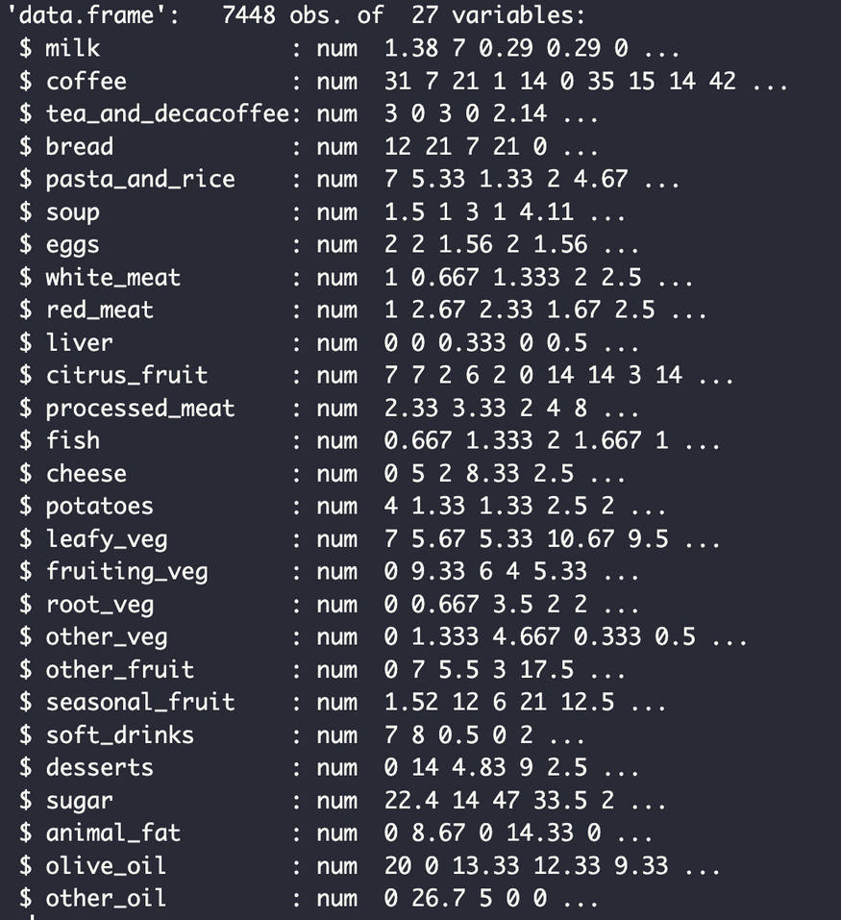




FOOD GROUPS
STEPS
We created 27 “food groups”starting from original “stability” dataset.
Every variable is a representation of the possible portion of food per week by each respondent.
These food groups were used in both PCA analysis and Factor analysis.

Slide 16
FOOD GROUPS
STEPS
Cheese
Potatoes
Leafy Vegetables
Fruiting Vegetables
Root Vegetables
Other Vegetables
Other Fruits
Seasonal Fruits
Soft Drinks
Desserts
Sugar
Animal Fat
Olive Oil
Other Oil
Milk
Coffee
Tea and Decaffeinated Coffee
Bread
Pasta and Rice
Soup
Eggs
White Meat
Red Meat
Liver
Citrus Fruit
Processed Meat
Fish
We created 27 “food groups”starting from original “stability” dataset.
Every variable is a representation of the possible portion of food per week by each respondent.
These food groups were used in both PCA analysis and Factor analysis.

Slide 17

Objective: Reduce dataset and find suitable number of components explaining the majority of the variance in the dataset
Method: PCA was performed on a set of variables representing dietary habits for whole the period of observation as well as subsets, splitter in teh following periods : 1991-1996, 1997-2002, 2003-2008.
Findings: PCA loadings highlight primary patterns of food consumption in each period.
PRINCIPAL COMPONENT ANALYSIS

Slide 18

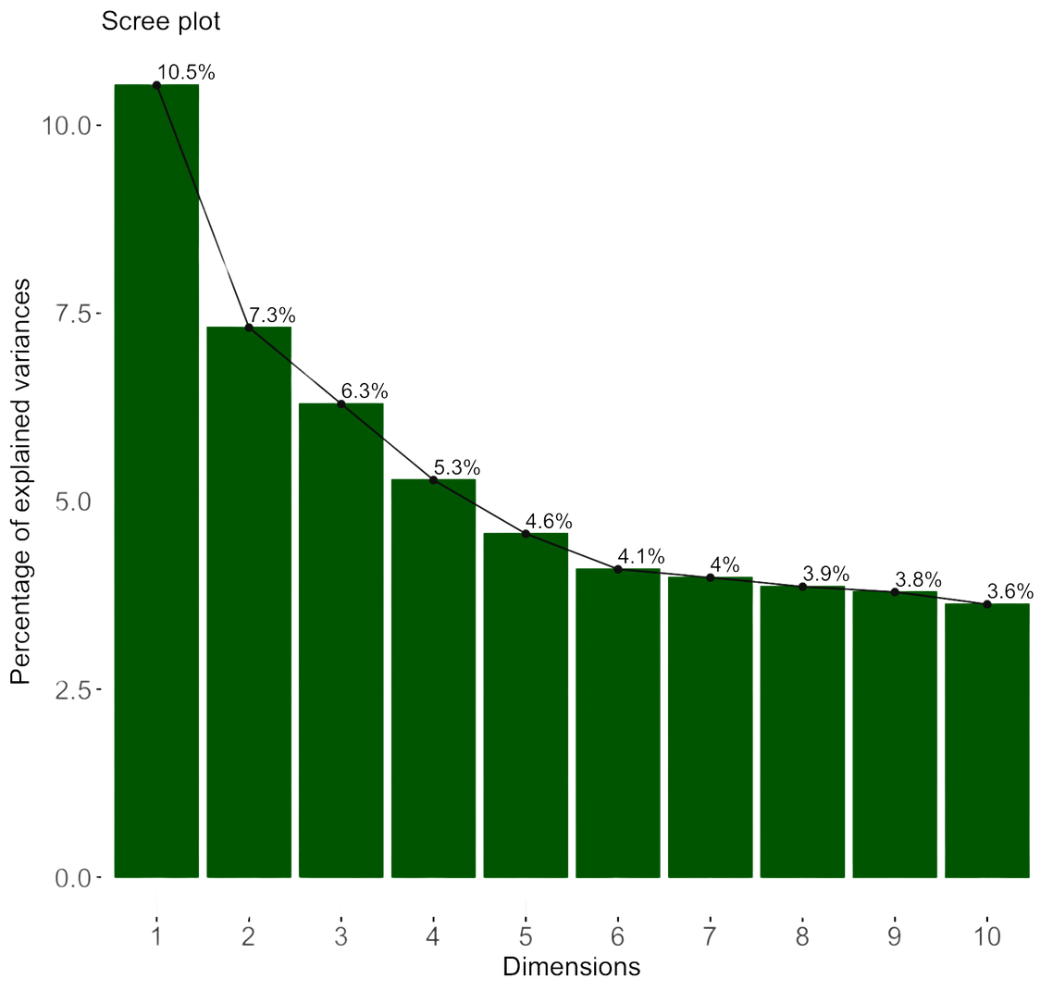
PRINCIPAL COMPONENT ANALYSIS
PC | EXPLAINED VARIANCE | CUMULATIVE VARIANCE
PC1 | 0.105 | 0.105
PC2 | 0.073 | 0.178
PC3 | 0.063 | 0.241
PC4 | 0.053 | 0.294
PC5 | 0.046 | 0.340
PC6 | 0.041 | 0.381
PC7 | 0.040 | 0.421
PC8 | 0.039 | 0.459
PC9 | 0.038 | 0.497
PC10 | 0.036 | 0.534

Slide 19
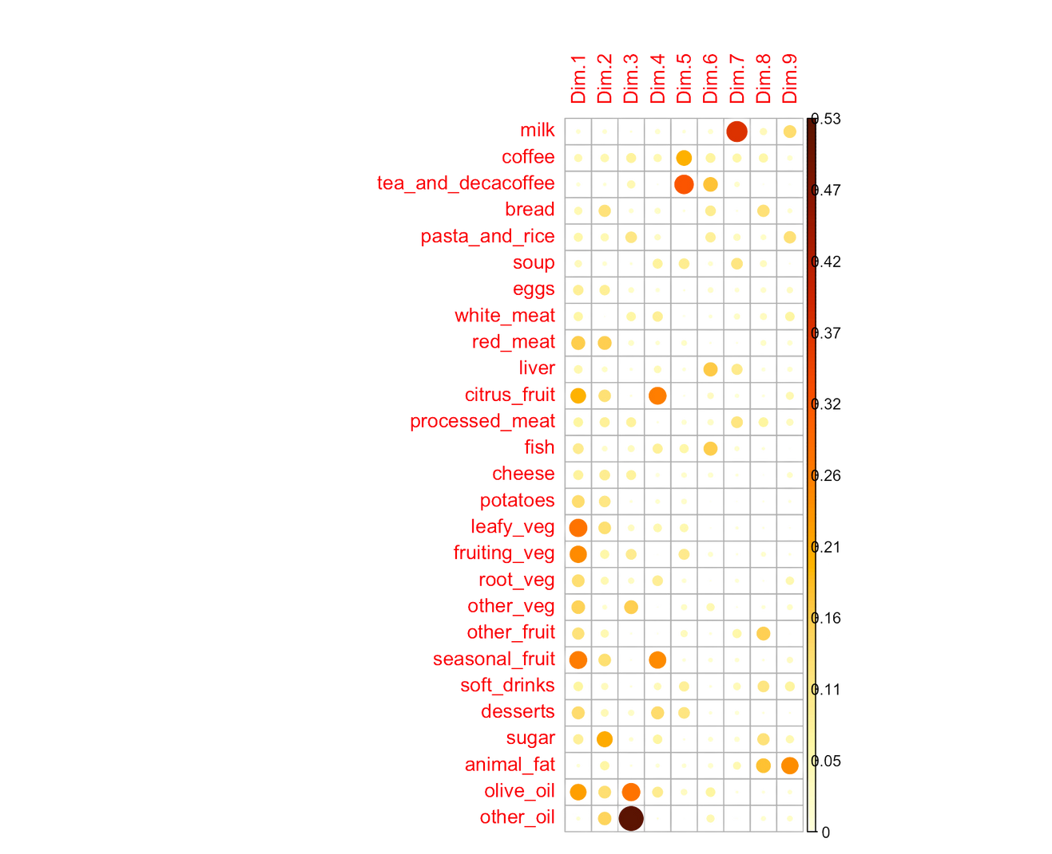
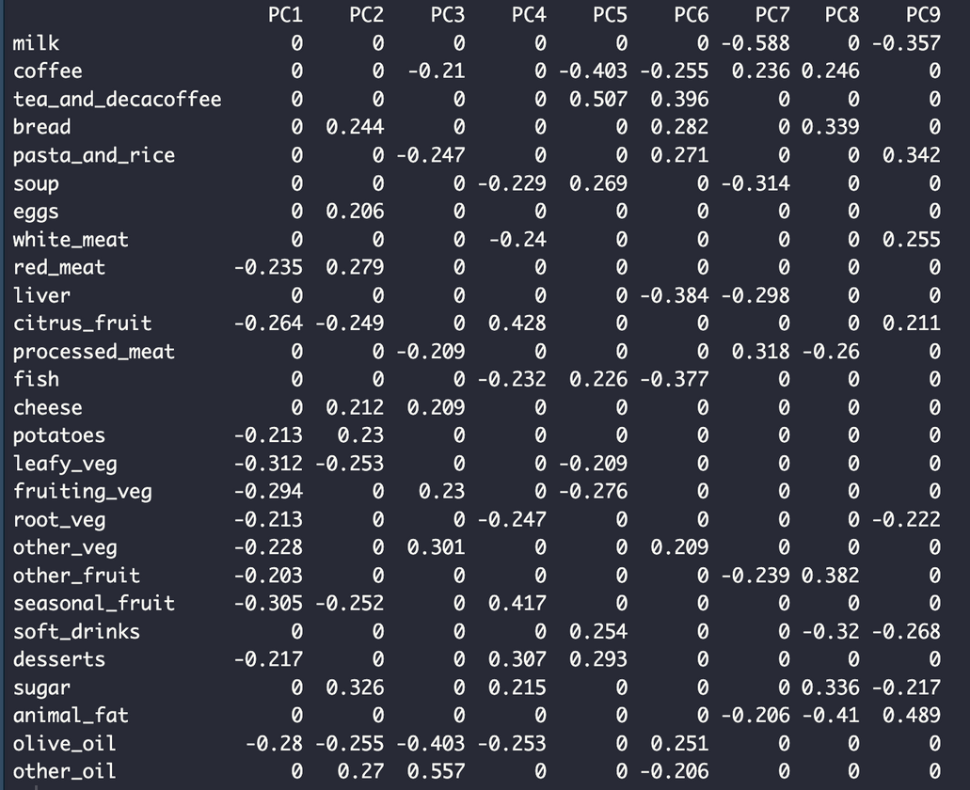


PCA

Slide 20
DIETARY PATTERNS
Vegetable and Fruit Avoidant: low consumption of fruits and vegetables
Starch and Protein Lovers : high consumption of bread, red meat, eggs and sugar, with negative loadings on fruits and vegetables.
Mixed Mediterranean Plate: mixed loadings, with negative loadings on coffee, pasta, and processed meat, and positive loadings on cheese, fruiting vegetables, and other oils.
Sweet Tooth vs. Savory Eaters: contrast between sugary foods (positive loadings) and savory foods like soup, white meat, and root vegetables (negative loadings).
Beverage Enthusiasts: high consumption of non-alcoholic beverages, especially tea, decaffeinated coffee, and soft drinks.
Traditional Carbs and Dairy: negative loadings on coffee, liver, and fish, with positive loadings on cheese, bread, and pasta/rice.
Processed Foods Dominance: strong negative loading on milk and liver, and a positive loading on processed meat, indicating a pattern of low dairy and organ meat consumption and high processed meat consumption.
Balanced Diet with Reduced Soft Drinks: positive loadings on milk, soup, other fruit, and sugar, with negative loadings on soft drinks and animal fat.
High Lean Meat, Low Fat Consumption: contrast between high white meat consumption (positive loading) and low consumption of milk, root vegetables, soft drinks, and sugar (negative loadings).

Slide 21
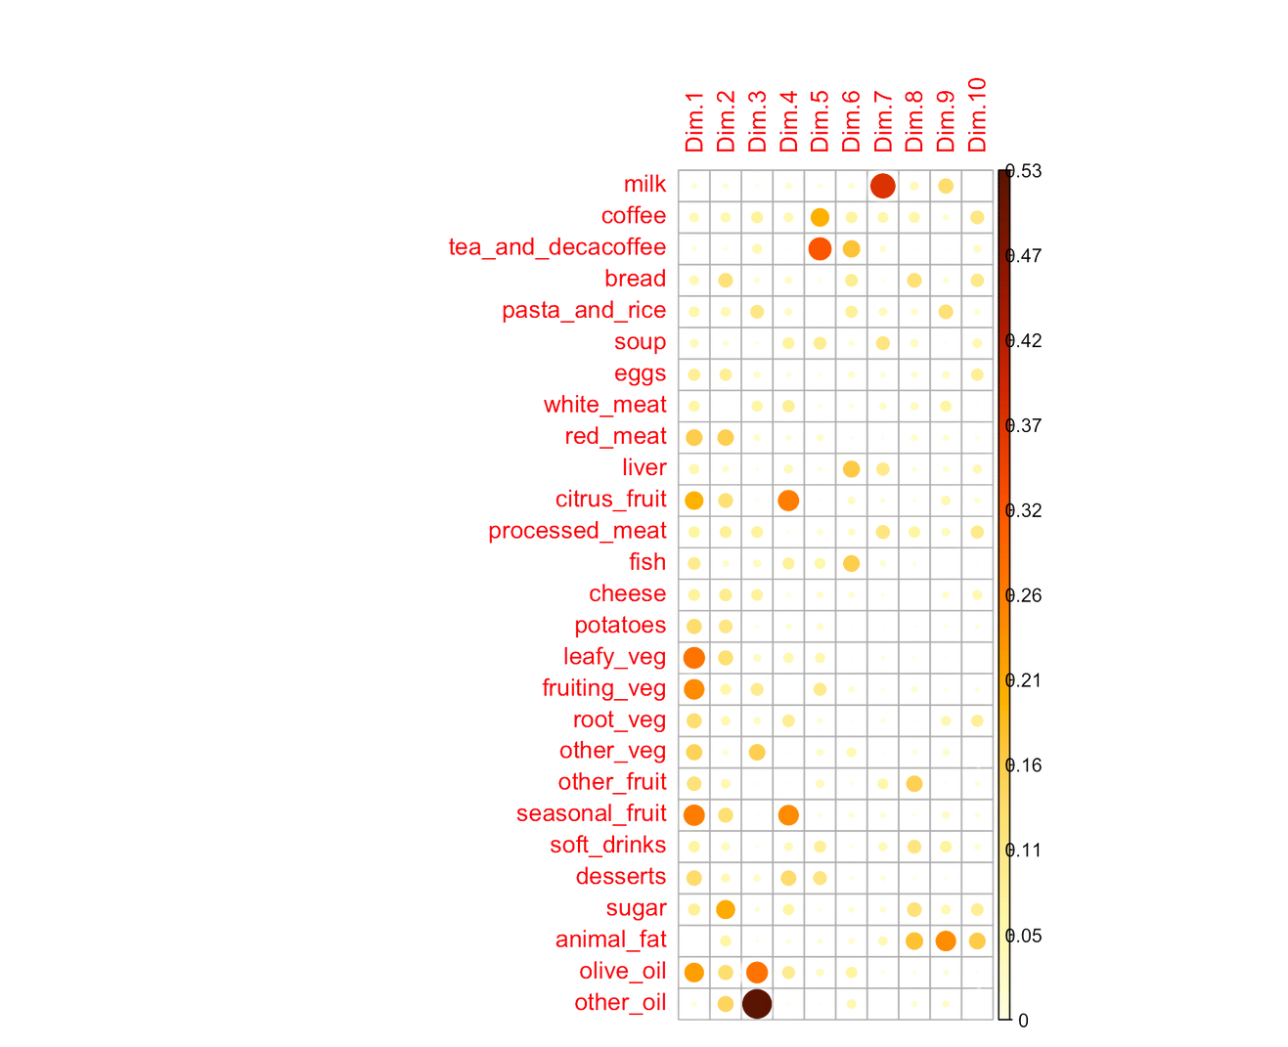
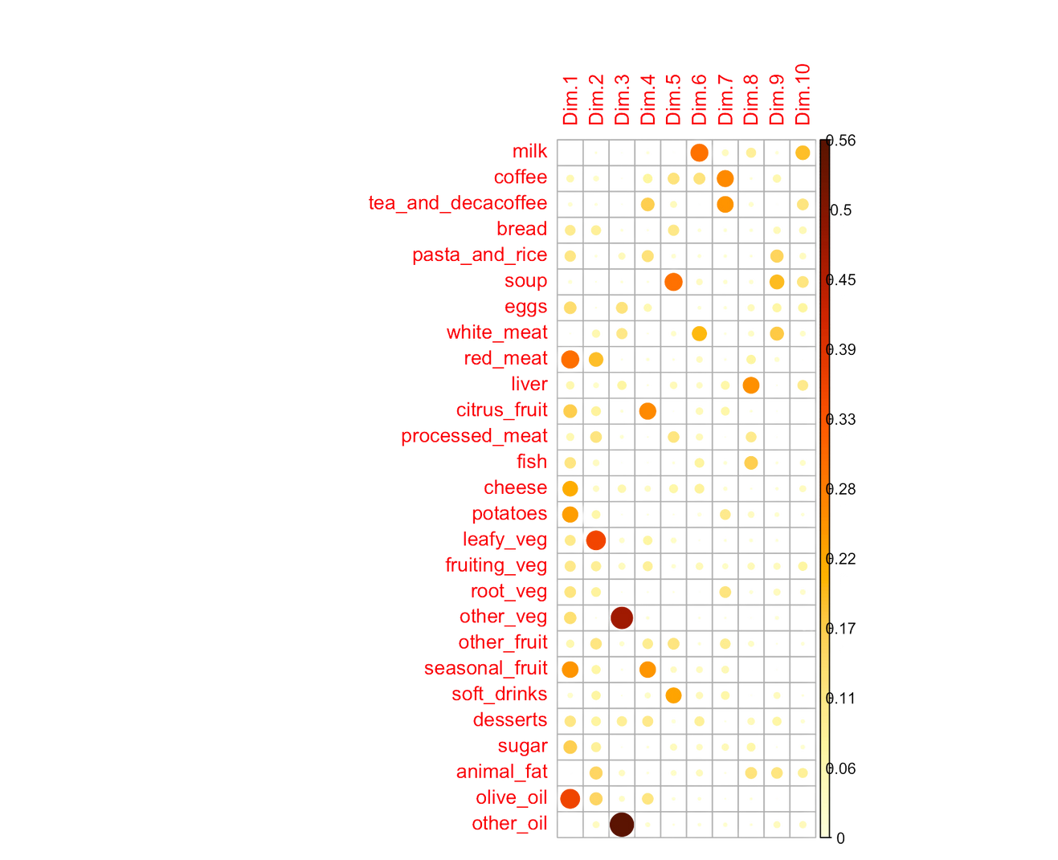
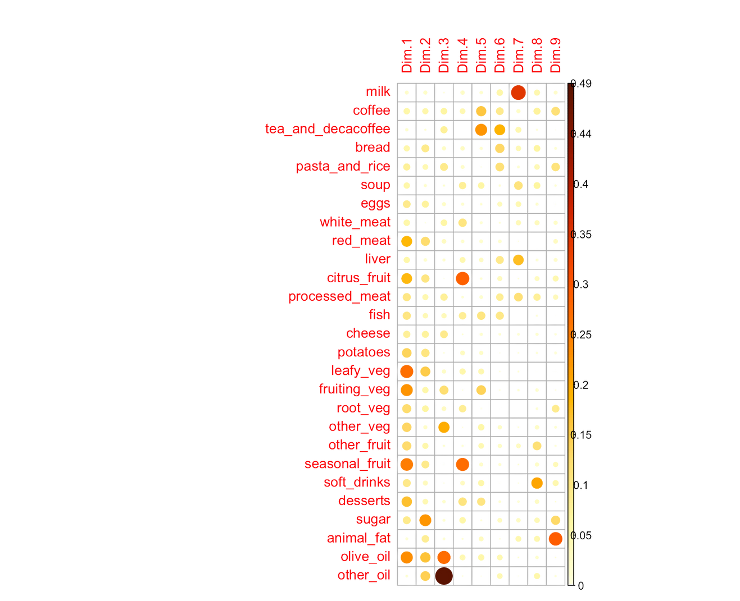
PCA over time
1991-1996
1997-2002
2003-2008

Slide 22
Final Results and Interpretations
PC1
91-96: PC1 is characterized by low loadings on fruit and vegetables (citrus_fruit, leafy_veg, fruiting_veg, root_veg, other_veg, other_fruit, seasonal_fruit), suggesting a low intake of these foods.
97-02: In this period, PC1 also shows similar negative loadings, indicating a continued low consumption of fruits and vegetables.
03-08: This pattern slightly diminishes, with increased consumption of olive_oil, fruits and vegetables, suggesting a greater adoption of Mediterranean diets rich in olive oil and potentially an increase in vegetable intake.
Trend: Growing Nutritional Awareness of the benefits of the Mediterranean diet. Low fruit and vegetable consumption is a constant, with a slight trend towards greater use of olive oil in recent years.

Slide 23
Final Results and Interpretations
PC2
91-96: positive loadings on sugar, bread and butter, suggesting a diet high in carbohydrates, sugars and fat.
97-02: negative loadings on sugar, processed_meat, red meat and bread indicating decreased consumption of sugars and processed meats.
03-08: The loading on sugar, red meat and bread decreases.Positive loadings on fruits, vegetables and olive oil suggest a healthier diet
Trend: Sugar and carbohydrate consumption is high in the first two periods, with a slight decline in the most recent period and with an increase in healthier food choices like fruits and vegetables.

Slide 24
Final Results and Interpretations
PC3
91-96: Positive loadings on tea and decaf coffee, cheese and vegetables and negative loadings on processed meat, indicating lower consumption of processed foods.
97-02: negative loadings on some vegetables and other oils, positive loadings on coffee, pasta and process meat
03-08: The loading on sugar, red meat and bread decreases.Positive loadings on vegetables, white meat and eggs suggest a healthier diet
Trend: Sugar and carbohydrate consumption is high in the first two periods, with a slight decline in the most recent period.

Slide 25
Final Results and Interpretations
Economic Growth:
1990s: Economic growth led to higher disposable incomes, resulting in increased consumption of convenience and processed foods.
2000s: Continued economic growth, but with a shift towards healthier food choices driven by higher health awareness and public health campaigns.
Health Awareness:
Late 1990s to 2000s: Increased public awareness of health risks associated with high sugar, processed food, and red meat consumption, leading to healthier dietary choices.
Urbanization:
1990s-2000s: Urbanization leading to busier lifestyles and initially higher reliance on convenience foods, followed by increased availability and consumption of healthier options in urban settings.

Slide 26
Factor Analysis: The main idea of factor analysis is to “explain” correlations between observed variables in terms of a few unobservable variables, commonly called factors or latent variables.
Objective: We used factor analysis to identify the main dietary patterns and compare their prevalence over time.
Methodology: We divided the data into three periods: 1991-1996, 1997-2002, and 2003-2008. For each period, we applied factor analysis to identify the main dietary patterns. We then calculated the percentage adherence to each pattern.
Factor Analysis

Slide 27
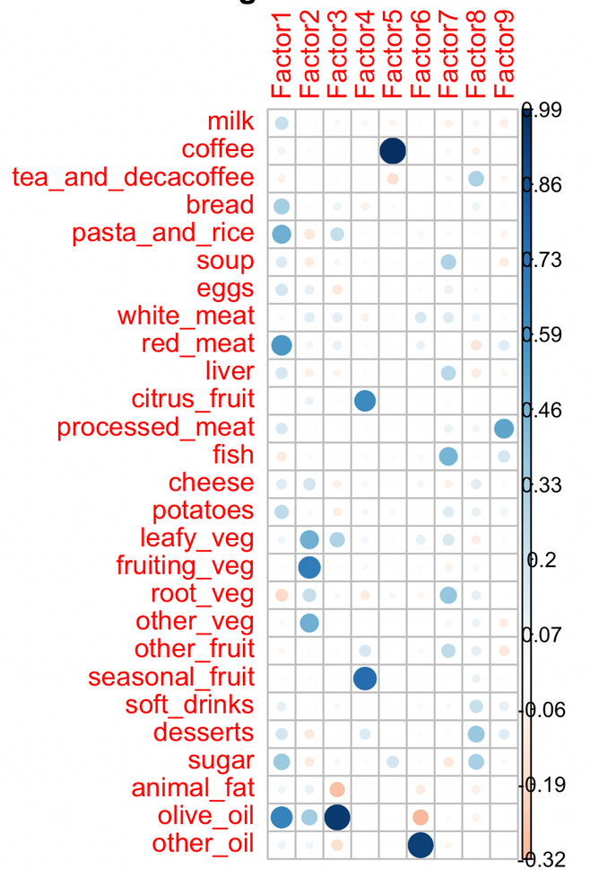
Dietary Patterns 1991-1996
Starch-rich: Bread, Pasta/Rice, Red Meat, Olive Oil
Vegetables: Fruiting vegetables, Leafy vegetables, Other vegetables
Olive Oil: Olive Oil
Fruits: Citrus fruit, Seasonal Fruit
Coffee: Coffee
Vegetable Oils: Other Oils
Fish: Soup, Fish, Root Vegetables
Sweets and Beverages: Tea and Decaffeinated Coffee, Desserts, Soft Drinks
Cured Meats: Processed Meats

Slide 28
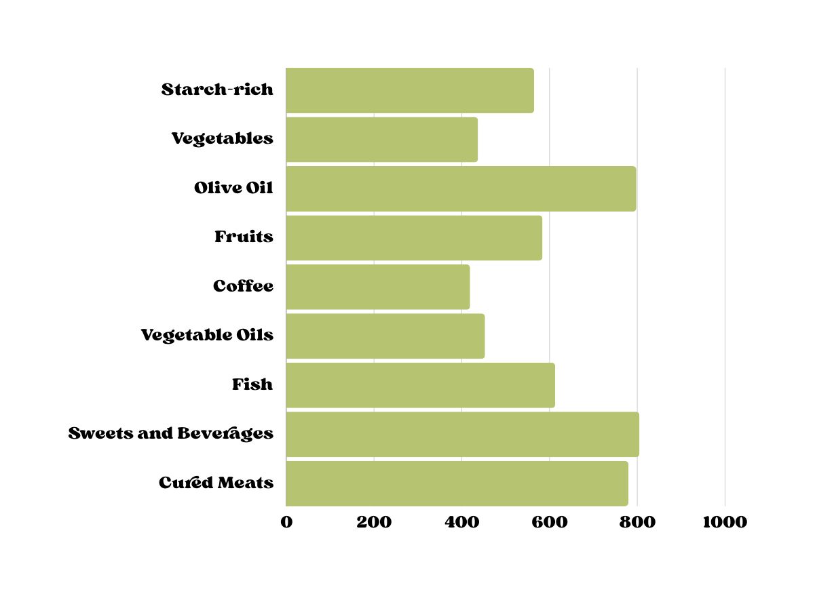
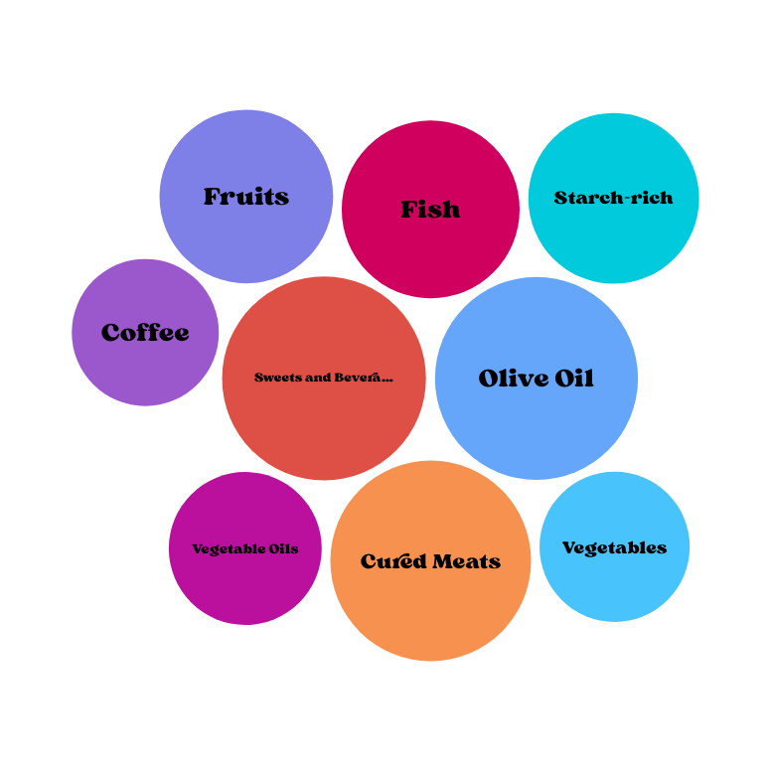
Adherence

Slide 29
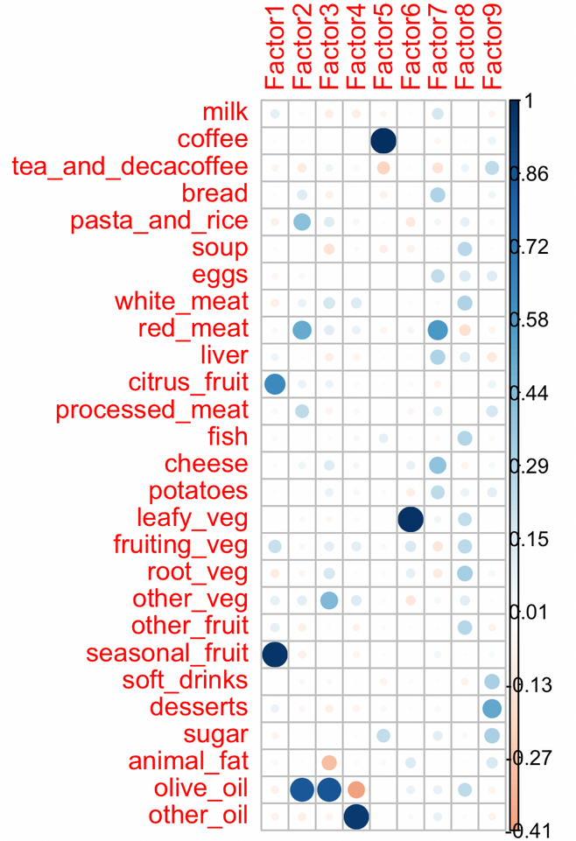
Dietary Patterns 1997-2002
Fruits: Citrus fruit, Seasonal Fruit
Starch-rich: Pasta/Rice, Red Meat, Olive Oil
Olive Oil: Olive Oil
Vegetable Oils: Other Oils
Coffee: Coffee
Vegetables: Leafy vegetables
Red Meat and Derivatives: Eggs, Red Meat, Cheese
White Meat and Fish: Soup, White Meat, Fish, Leafy vegetables, Fruiting Vegetables
Sweets and Beverages: Tea and Decaffeinated Coffee, Desserts, Soft Drinks, Sugar

Slide 30
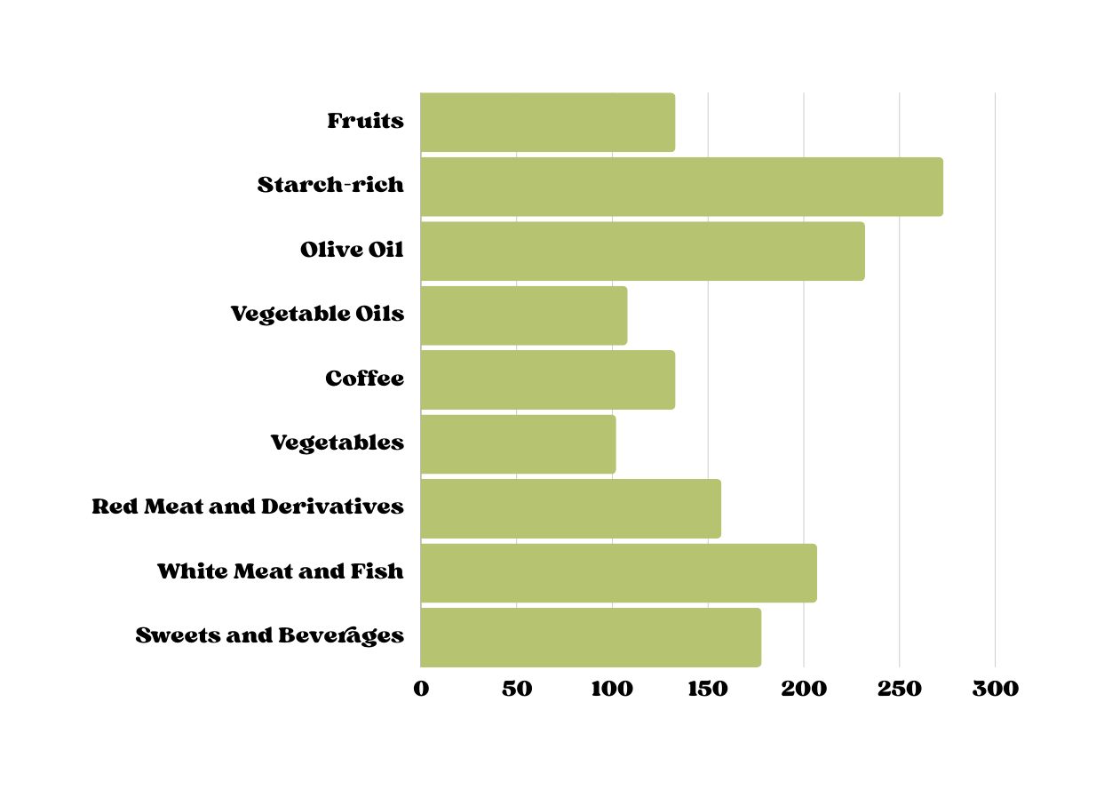
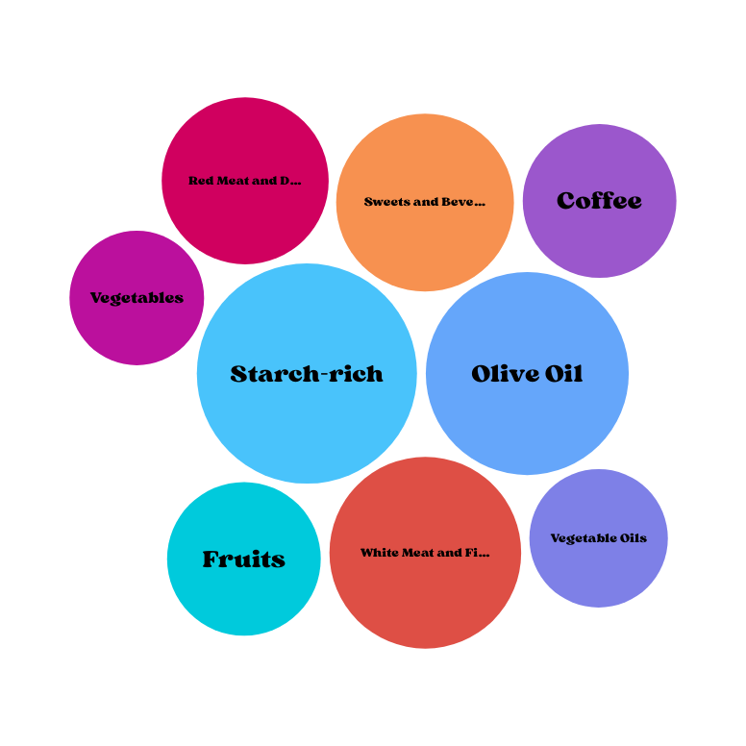
Adherence

Slide 31
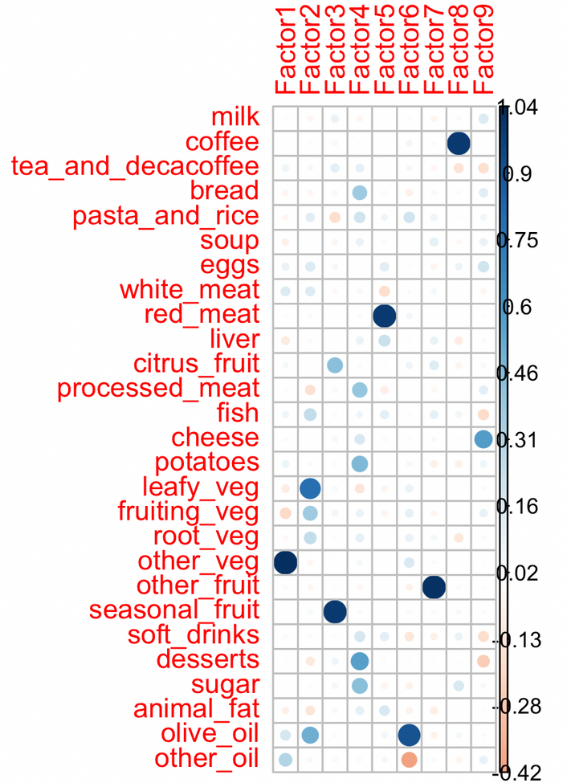
Dietary Patterns 2003-2008
Other Vegetables: Other Vegetables
Vegetables: Leafy Vegetables, Fruiting Vegetables, Root Vegetables
Fruits: Citrus fruit, Seasonal Fruit
Comfort Foods: Bread, Processed Meat, Potatoes, Dessert, Sugar
Red Meat: Red Meat, Liver, Animal Fats
Vegetable Oils: Other Oil, Olive Oil
Other Fruits: Other Fruits
Coffee: Coffee
Cheese: Cheese

Slide 32
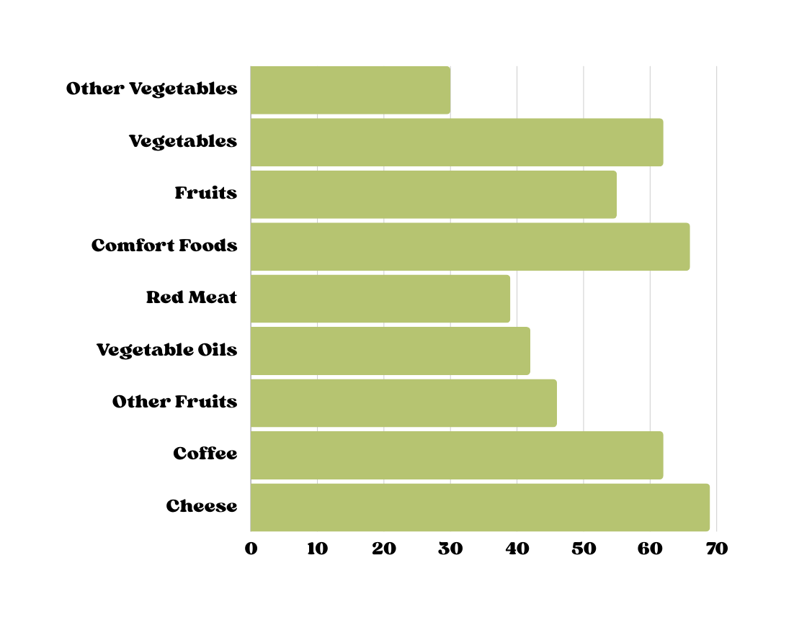
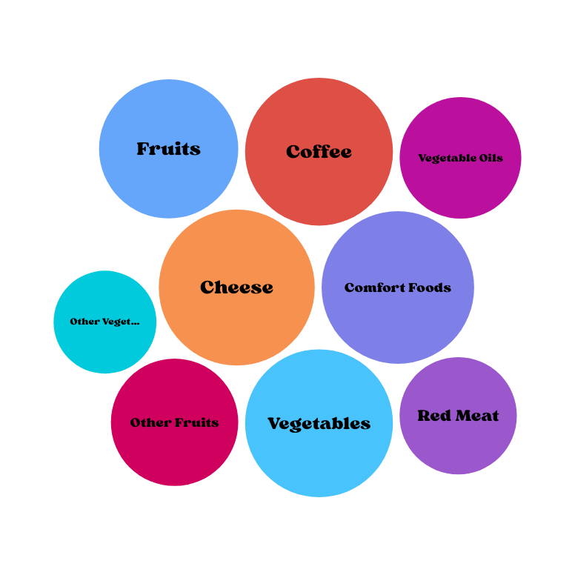
Adherence

Slide 33
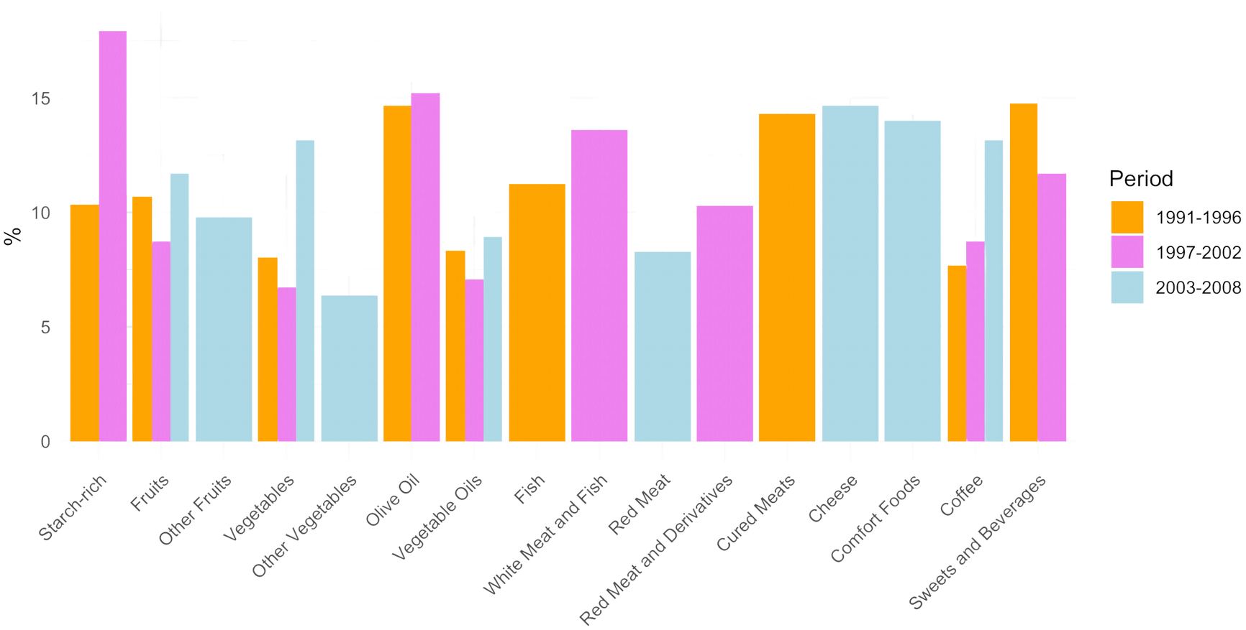
Distribution of Dietary Patterns Across Periods

Slide 34
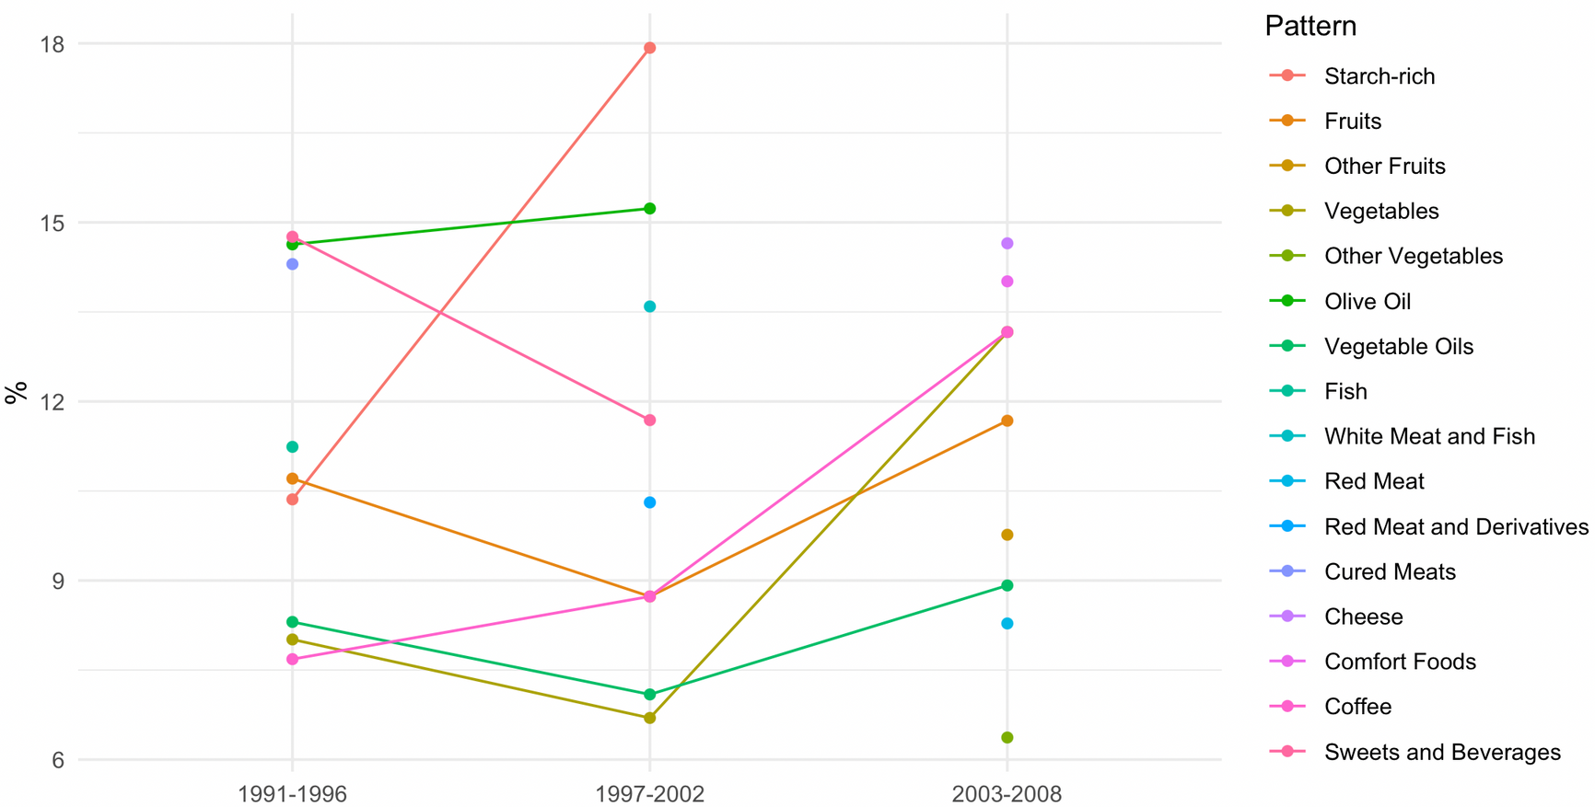
Trends of Dietary Patterns Over Time

Slide 35
Conclusion
The AFE (Exploratory Factor Analysis) shows partially different results compared to the PCA.
Specific patterns are highlighted in each period, which are not always found in other considered periods. In particular:
The "Starch-rich" pattern is only present in the first two periods, and subsequently, this dietary style is no longer found.
Fruit consumption is always present as a factor and remains relatively constant over the entire period.
Vegetable consumption is always present as a factor and increases significantly in the last period.
Olive oil consumption is distinctly high in the first two periods, while in the last period there is a trend to consume it along with other vegetable oils.
For the consumption of meat and fish, the results are mixed and it is not possible to identify trends.
Interestingly, a factor identified as "comfort food" is present only in the last period, composed of bread, processed meat, potatoes, dessert, and sugar.
However, the statistical performance of the three EFAs is not good; therefore, the results obtained cannot be considered robust. PCA is likely better for this phenomenon.

Slide 36
Thank you for your attention!

